Slide 1
Analysis of Repeated Measures
LongITools General Assembly Capacity Building Day
Ahmed Elhakeem (UOB)
https://github.com/aelhak/ARMLT_24

Slide 2
Objectives:
By the end of this lecture, you will be able to understand / explain:
Types of research questions that analysis of repeated measures can answer
Linear mixed effects models (LME), including difference between random intercept / random slope models, and how they can be used to model linear growth
Importance of allowing for nonlinear growth and how LME can be extended to model it by using splines
How LME can be extended to model (nonlinear) growth in unobserved (latent) sub-groups
We will focus on:
- continuous measures only (so not covering analysis of binary / categorical repeat measures)
- Population-average growth only (so not covering analysis of subject-specific growth)

Slide 3
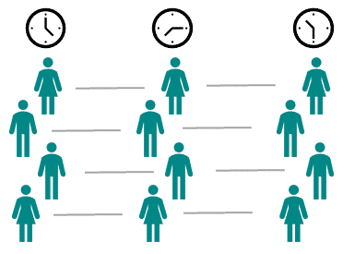
Repeated measures data
Also known as time-course data and longitudinal data
Nested structure e.g., repeat measures in same people – nested observations are not independent and this needs to be taken into account in the data analysis
ID | Occasion | y
1 | 1 | 23.4
1 | 2 | 31.2
1 | 3 | 36.6
2 | 1 | 25.6
2 | 2 | 33.8
2 | 3 | 40.0

Slide 4
Why use repeated measures analysis
Improved statistical power and precision
Answer research questions about growth e.g.,:
- how does an outcome change over time including the shape of the change / growth
- does growth rate vary across different sub-groups, e.g. sex (or some latent grouping)
- how growth rate/pattern might influence a later outcome
-> Improves understanding of the influences on health trajectories across the life course, and the effect of trajectories on subsequent outcomes
One type of repeated measures model that can take account of the nested structure and be used to answer these kinds of questions is the mixed effects model, with linear mixed effects models the most used version of this

Slide 5
Linear mixed effects models (LME)

Slide 6
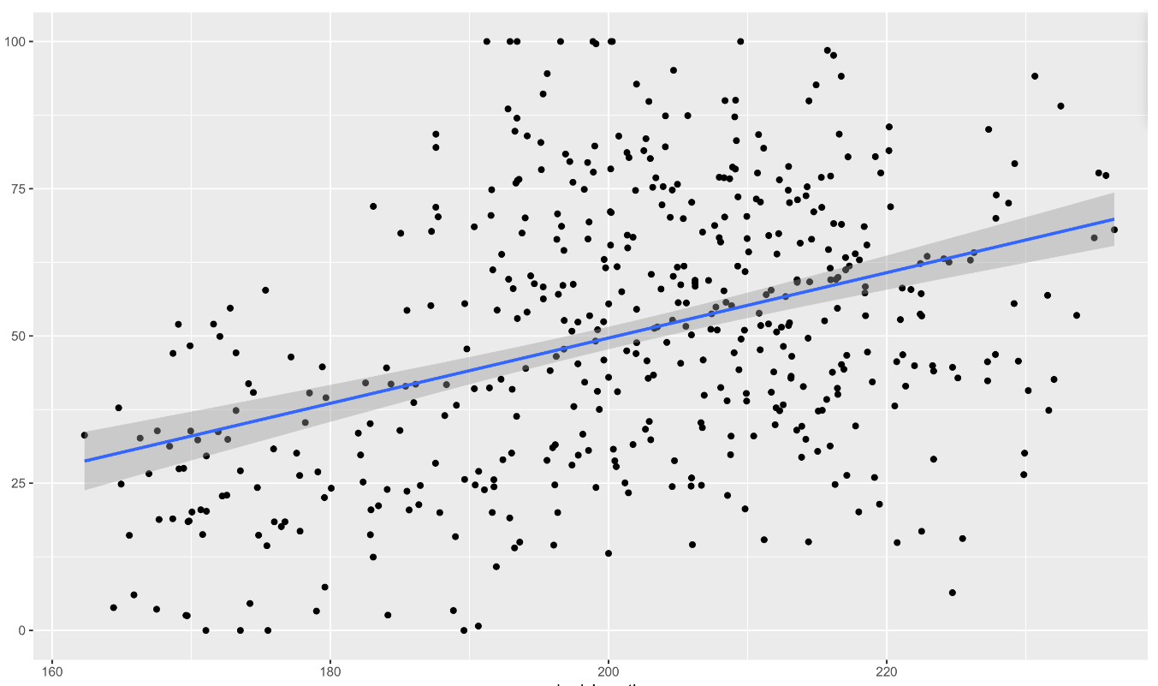
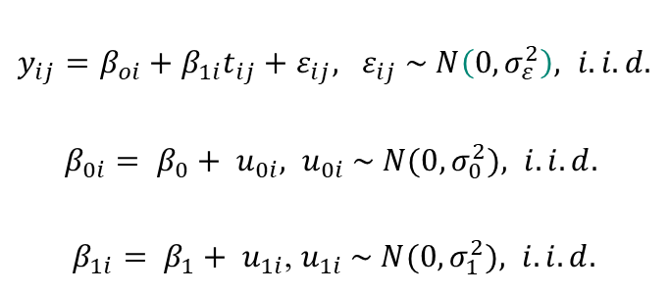
Mixed effects models
Also known as random-effects / multilevel / hierarchical models
LME evaluates the repeated outcome by a linear combination of the fixed and random effects
Can estimate a population-average trajectory as ‘fixed effects’ as well as variation of individual (subject-specific) trajectories around this average as ‘random effects’ - subject specific growth curves are the sum of the fixed and random parts of the model
Take missing data into account, assuming data are missing at random i.e. missingness depends on observed data
Models linear change in the outcome (e.g. weight) over time
Can include other co-variables e.g., predictors of change
$y_{ij}=β_{oi}+β_{1i}t_{ij}+ε_{ij}, ε_{ij} \sim N\left(0, σ_{ε}^{2}\right), i.i.d.$
$β_{0i}= β_{0}+ u_{0i}, u_{0i} \sim N(0, σ_{0}^{2}), i.i.d.$
$β_{1i}= β_{1}+ u_{1i}$, $u_{1i} \sim N(0, σ_{1}^{2}), i.i.d.$

Slide 7
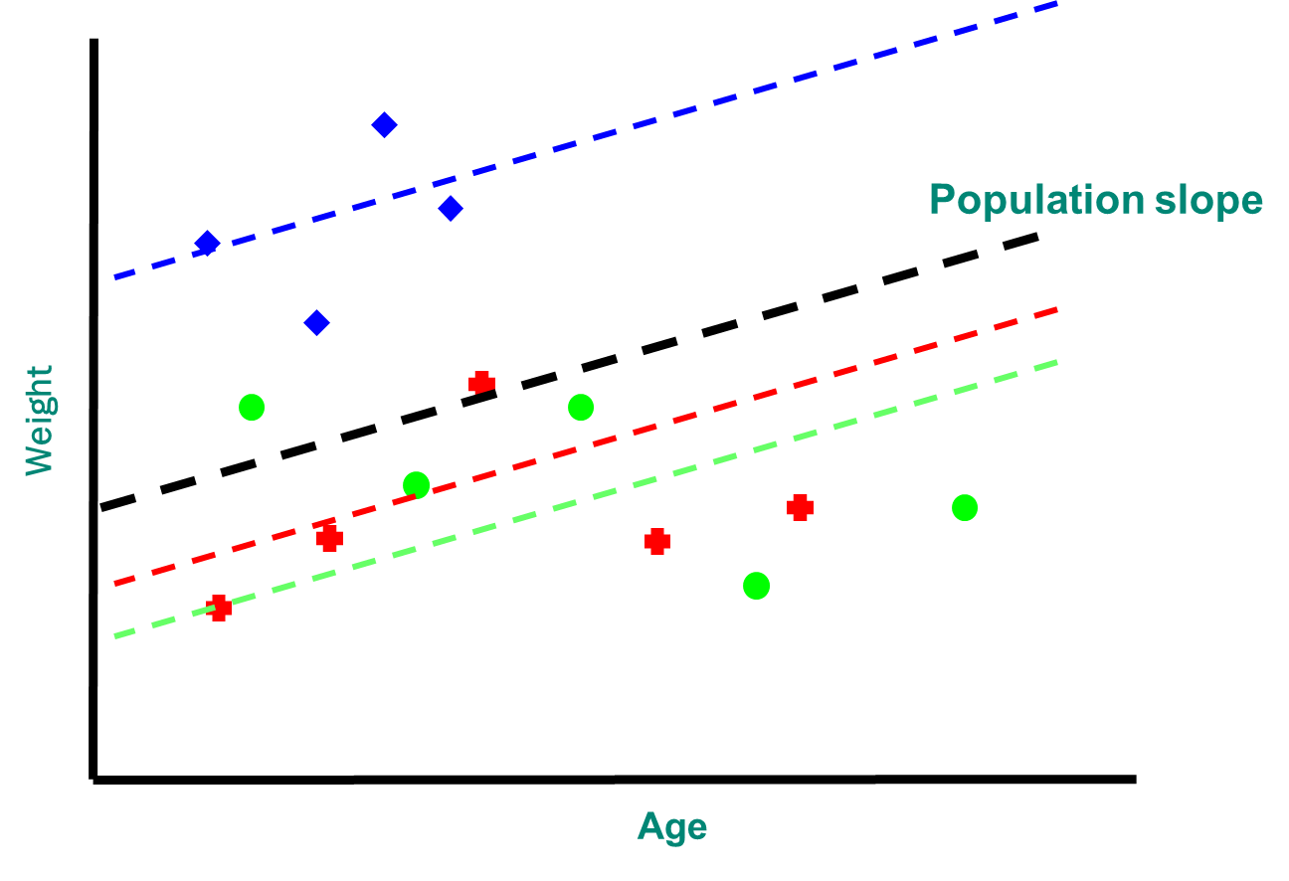
Random intercept model
Simplest version of a mixed effects model
Has a line for each individual and each line can have a different slope
Allow the outcome and slope to be higher or lower for each individual

Slide 8
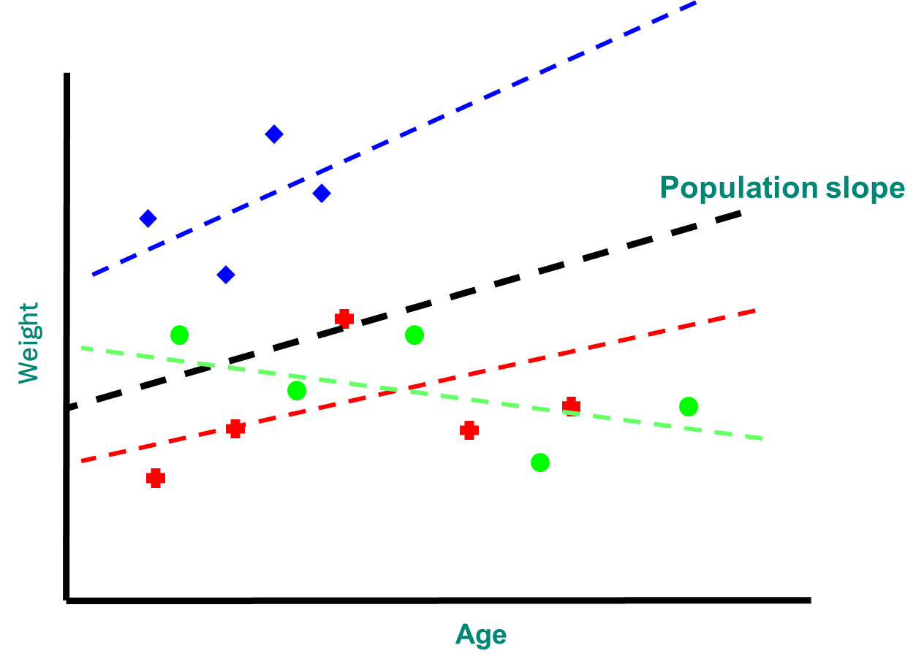
Random slope model
Random intercepts and random slopes (usually)
has a line for each individual and those lines are allowed to vary relative to the overall average line
linear mixed-effects (LME) model: repeated outcome is evaluated by a linear combination of the fixed and random effects
LME model of the linear change in the outcome (e.g. weight) over time:

Slide 9
Linear versus nonlinear growth
y
y
y
y
x
x
x
x
y
y
y
y
x
x
x
x
Notes:
Let’s start with a recap on what we mean by non-linear modelling. On this slide, we are looking at the relationships between continuous exposures and continuous outcomes. Typically, our first step is to fit a linear model. That means we estimate a single straight line, like those shown on the left of this slide, with the regression lines shown in green. We are assuming that for each unit increase in our exposure x, there is the same change in our outcome y, right the way across our distribution of x.
However, on the right side of the slide, with the lines shown in red, this is not the case. Here, our relationships are non-linear. That means, at different points in the distribution of x, we will see varying changes in y for a one unit increase in x.

Slide 10
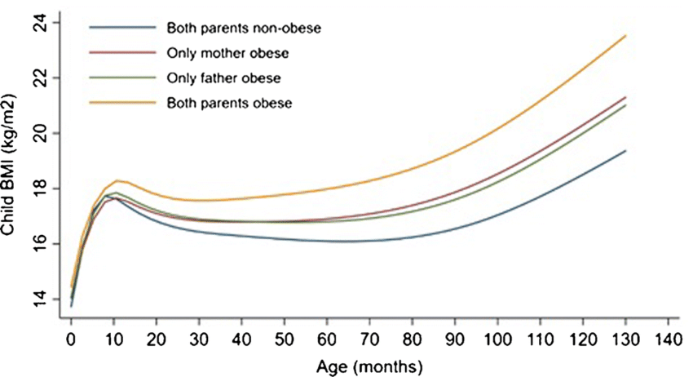
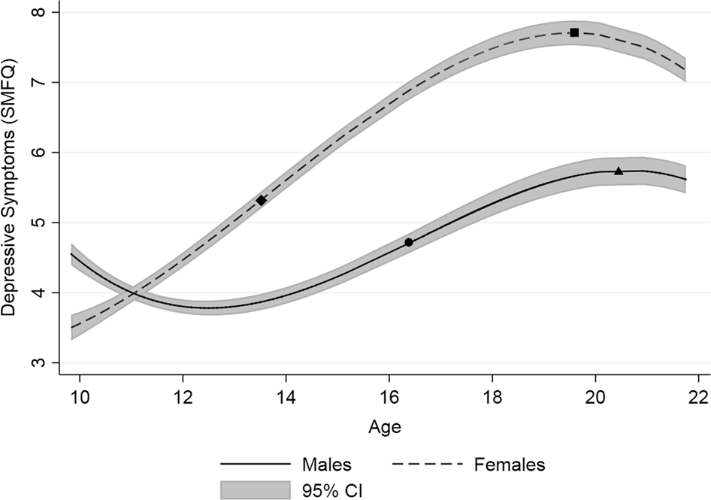
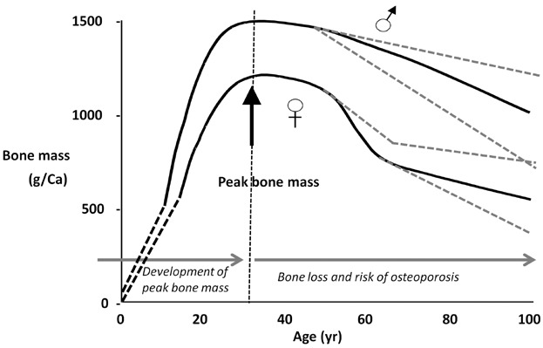
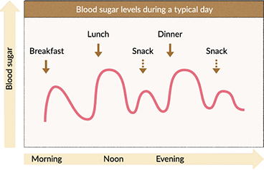
In many situations change / growth is not linear
Curr Diab Rep 2018
Kwong et al 2019
JBMR 2014
https://www.otsuka.co.jp/en/health-and-illness/glycemic-index/glucose-level/

Slide 11
In many situations change / growth is not linear
Spline functions can be used to model nonlinear change
Kwong et al 2019
Curr Diab Rep 2018
JBMR 2014
https://www.otsuka.co.jp/en/health-and-illness/glycemic-index/glucose-level/

Slide 12
Using splines in LME for the analysis of nonlinear growth

Slide 13
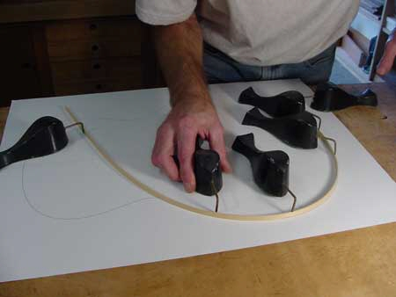
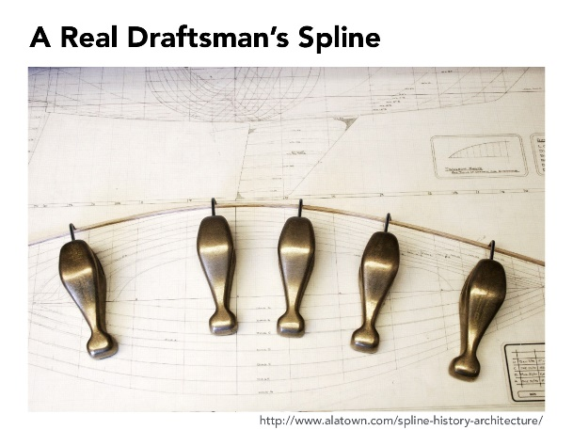
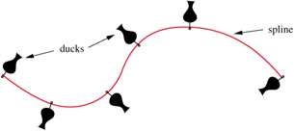
Splines
Physical crafting tools: flexible thin strip of wood / metal used to draft smooth curves e.g., for boats. Strips would bend according to number and position of weights & take the shape
In statistics, spline functions can be used to mathematically reproduce flexible shapes
A spline function is a set of piecewise polynomials that are smoothly joined (i.e., constrained to be continuous) at turning points (called knots)
Splines are formed using spline basis functions (the dimensional space containing each element from a set of local polynomials)
Polynomial degree & method of knot placement generally is what distinguishes b/w different spline functions, e.g., degree 1 for linear spline and degree 3 for cubic spline

Slide 14
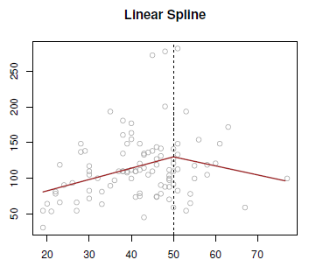
Linear spline
Connected straight lines with a change in slope at each knot
Can be used in LME to describe growth as a series of connected lines (linear slopes) joined at knot points
Linear spline function for age (20–70 years) with one knot point at age 50 years produces 2 different linear slopes of the repeated measure (e.g., weight): 20 to ≤50, and 50 to ≤70 years
Linear growth rate is described over age windows (1st derivative is not continuous at the knots)
There can be an abrupt change from positive to negative growth – curve shape is unrealistic
Linear change

Slide 15
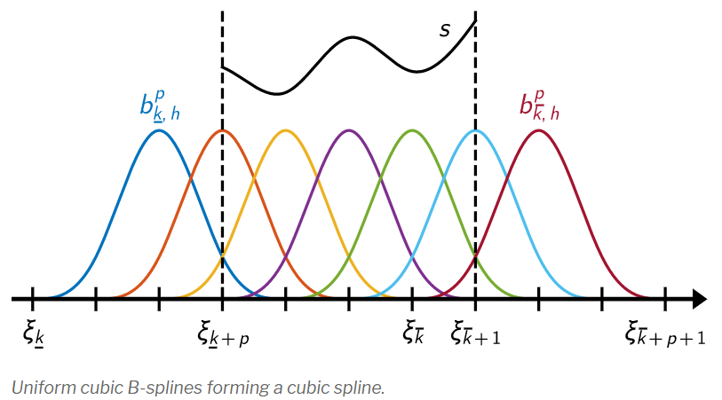
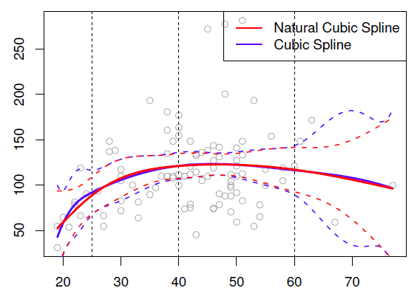
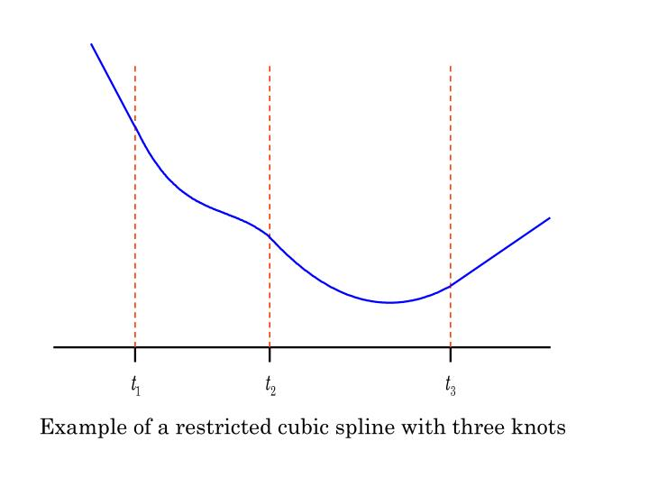
Cubic and restricted cubic (natural) spline
A cubic spline is set of connected cubic polynomials with slope and continuity constraints at each knot – continuity constraints -> more parsimonious for complex shapes than linear spline with many knots
Cubic splines have continuous 1st (velocity) and 2nd (acceleration) derivatives) -> possible to differentiate the growth curve to get a velocity curve, and identify the nature of the peak
A natural spline is a cubic spline with additional constraints of linearity before (usually) the first knot and after the last knot
Linearity constraint allows trajectory to be less erratic at the tails: more reliable than linear splines and (unrestricted) cubic splines
Natural spline models growth by cubic polynomials between internal knots, and with a line before the 1st knot and after the last knot
https://bsplines.org/

Slide 16
Choosing number and location of knots
Flexibility/smoothness of splines is determined by the number and position of knots
A small number of knots (~ 3 to 5 knots) provides a good fit to most patterns however, with many repeat measurements more knots may be required
For natural splines, knot position less important than number (both important for linear splines)
Common approaches to knot placement:
quantile placement: knots at equal centiles (of age distribution) or at Harrell’s centiles
equidistant placement: equally spaced knots over the range of age
fit a smoothing curve & select knot position based on this (e.g., geom_smooth() / FPs)
placing the knots at the mean age of data collection / where data are available
subject knowledge: e.g., to test sensitive periods

Slide 17
Model comparison / selection
Model comparison and selection can be done by a combination of informal checking and formally testing difference between fitted models
Models with different knots can be compared informally e.g., by inspecting plots from competing models and avoiding those showing unrealistic trajectory shapes, and by examining residuals for the fitted models
Valid comparison between nested models with different knot points can be done using standard likelihood ratio tests under either ML or REML estimation
Models with non-nested mean structures can be compared informally; valid comparison using information criteria (e.g, BIC) can be done provided ML estimation is used
A model with k-1 evenly spaced knots will not generally be nested within a model with k evenly spaced knots, same for models using evenly-spaced quantile placement of knots

Slide 18
Latent trajectory models

Slide 19
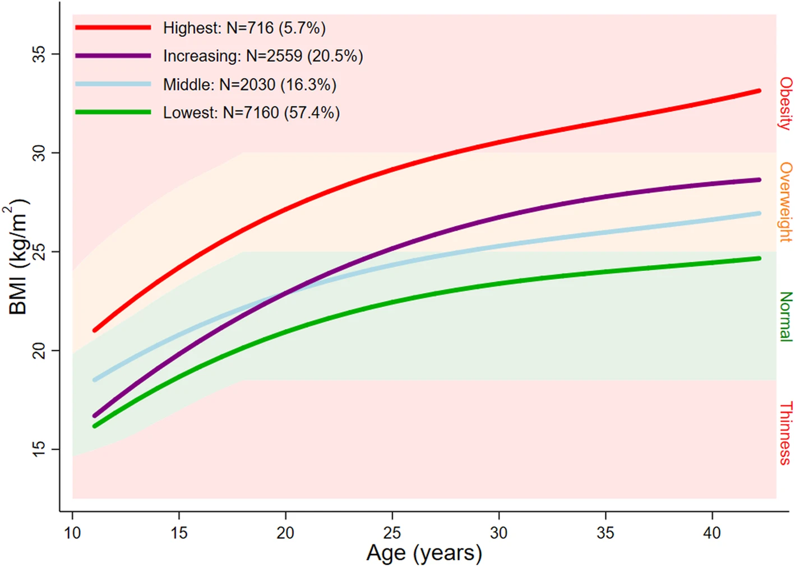
Latent trajectory models (LTM)
So far, we considered models that assume the population is homogenous and described at the population level by a mean trajectory, with variability of individuals about this mean
LTMs assume that there is a heterogenous population composed of unknown subgroups (latent classes) of individuals, each characterised by a unique mean trajectory profile
Address different research hypothesis where heterogeneity in the mean population-average trajectory is of key interest. Aim to minimise within-group variance and maximise between-group differences so that individuals are more similar within groups than between groups
Each individual has a probability of belonging to each latent class and is assigned to the class with the highest probability. Class membership is defined using a latent discrete random variable, with membership probability described by a multinomial logistic model
Norris et al. BMC Med 2021

Slide 20
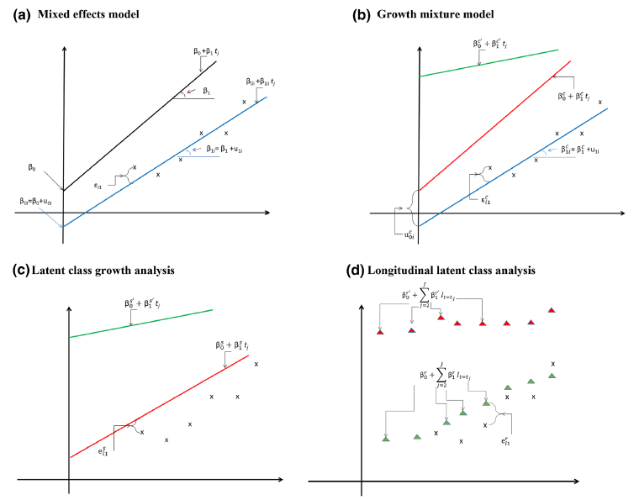
LTM types
Three main types of LTMs:
growth mixture models (GMM): multiple mixed-effects models for each population sub-group
group-based trajectory model (GBTM) / latent class growth analysis: assume no variability between individuals within sub-groups
longitudinal latent class analysis: ignores longitudinal structure
lcmm can fit GMM and GBTM
Eur J Epidemiol 2020

Slide 21
LTM – model estimation and selection
Model estimation is conditional on a pre-specified number of classes i.e., fit models with different number of classes and use approaches to select the optimal model
Growth can be described as nonlinear, e.g., using a natural spline curve in each class
Class-specific covariances for individual-level error terms can be included
Models with > 1 class prone to local maxima solutions (convergence to best solution in a neighbourhood of the parameter space, rather than the global maximum) - Important to try to avoid local maxima – e.g., by using different starting values for model estimation
Fixed and random effects can be class-specific
Optimal number of classes identified through a combination of approaches
interpretability and plausibility of classes
information criteria
entropy (statistic for class separation)
numerically meaningful sub-groups
Goodness of fit and discrimination capacity of selected models can be assessed e.g., by checking class membership probabilities and plotting subject-specific and marginal residuals

Slide 22
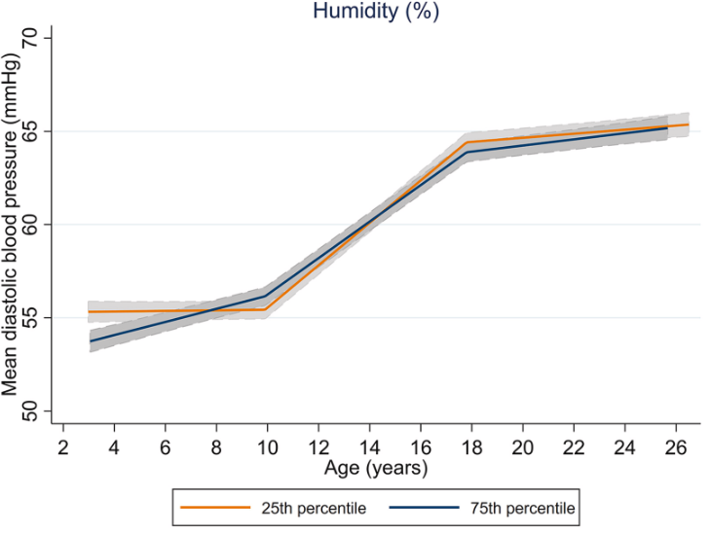
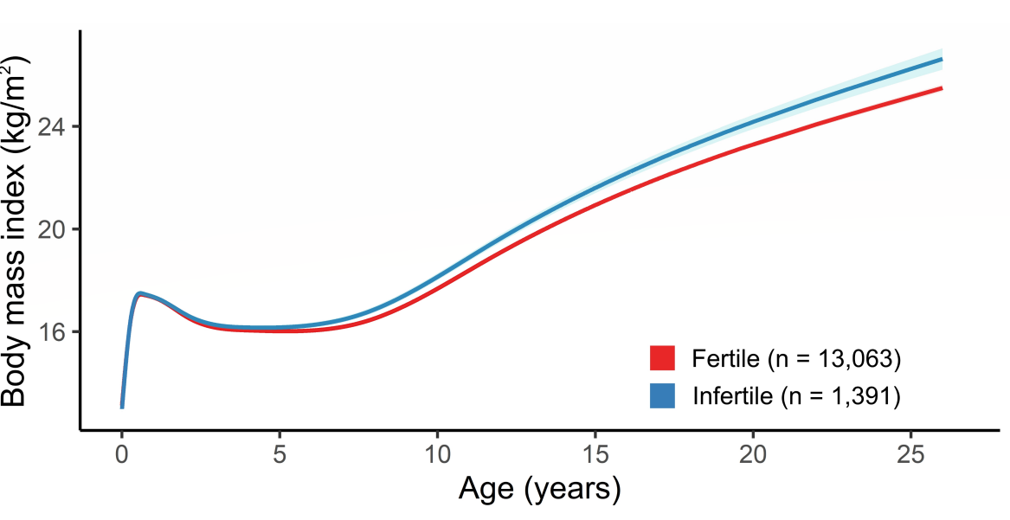
Relating growth to exposures/outcomes
Choice of method will depend on the research aims
Exposure variables can be added in LME spline models as interactions with age splines to test their effect on trajectories
Exposures and outcomes can be related to LTM subgroups using a joint model or a multistage process where trajectories are first identified and used in separate models to examine associations with exposure/outcome
Important to identify potential biases and explore ways for mitigating: missing data, confounding, residual confounding, negative control variables, cross-cohort comparisons, triangulation
JACC: Advances 2024
Fertil Steril 2024

Slide 23
Choosing a modelling approach
Any of the modelling techniques presented may be used to model growth
Choice will be determined by the research question (including rationale for population-average or data-driven approaches), complexity of the trajectory, and data availability (sample size and frequency of repeats)
When the main aim is to quantify growth rate at different periods of the life-course, then linear splines may be preferred because of their more interpretable slope coefficients. If the aim is to describe the shape of the trajectory, then natural cubic spline LME model is more useful – but these can also be used to obtained predicted outcomes at specified ages of the life course
GMM generally can take long time to run, particularly in larger cohorts; less complex GBTM are faster, but sub-group differences may just reflect within-class variability – which is likely to be absorbed by the random effects in GMMs. With LTMs, It is difficult to determine the optimal number of sub-groups, & whether classes are meaningful. Model selection is often subjective, and trajectory subgroups tend to be cohort-specific and do not replicate in other cohorts

Slide 24
R code

Slide 25
LME for linear change in outcome in R
lmer (depvar ~ fe_equation + (re_equation), options)
Fixed effects part of model
Random effects part of model
Random intercept model
lmer(
y ~ age + (1 | id),
data = dat
)
Random slope model
lmer(
y ~ age + (age | id),
data = dat
)

Slide 26
Linear splines in R
https://www.rdocumentation.org/packages/lspline/versions/1.0-0/topics/lspline
Set up using the bs() function from the splines package
For convenient parametrisation of spline coefficients, use lspline package which is a wrapper for bs()
Coefficients are expressed as the linear slopes of consecutive spline segments (default), or as the slope change at consecutive knots
To use in a linear mixed effects model, replace the age variable with a function for age (same for both lmer() from the lme4 package and lme() from nlme package)
lspline contains three functions:
lspline(x, knots) # to manually specify knots
qlspline(x, q) # quantile knot placement (at equal quantiles (input a number) or specified quantiles (input a vector of locations) of x
elspline(x, n) # equidistant placement – equal intervals of x

Slide 27
Natural splines in R
https://www.rdocumentation.org/packages/splines/versions/3.6.2/topics/ns
ns(
x, # predictor column name (age)
df, # number for degrees of freedom, used for quantile knot placement (at equal quantiles). The number of knots is df-1
knots, # can be used instead of df for manual knot placement by supplying a vector for the location of knots
)
Set up using the ns function from the splines package
To use in a linear mixed effects model, replace the age variable with a function for age (same for both lmer() from the lme4 package and lme() from nlme package)

Slide 28
LTMs in R
https://rdrr.io/cran/lcmm/man/hlme.html
https://search.r-project.org/CRAN/refmans/lcmm/html/gridsearch.html
https://rdrr.io/cran/lcmm/man/summarytable.html
R package lcmm can fit GMM and GBTM using the hlme function (data in long format)
First fit 1 class model & use it with the gridsearch function to generate starting values for LTMs with 2+ classes
Then use summarytable to get summary stats on the models
hlme(
fixed, # 2 sided two-sided formula for fixed part of the mixed effects model
mixture, # one-sided formula for class-specific fixed effects
random, # one-sided formula for random part of the mixed effects model
subject, # name of grouping structure
classmb, # covariates to use in class-membership multinomial logistic model
ng = 1, # number of latent classes
idiag = FALSE, # unstructured variance-covariance matrix for random effects
nwg = FALSE, # random effects variance-covariance matrix common over classes
cor = NULL, # no model of correlation between repeated observations
data, # data frame containing variables
)
gridsearch(
m, # model to estimate
rep, # number of departures from random initial values
maxiter, # number of iterations in the optimization algorithm
minit, # used to generate random initial values
)
1. randomly generating rep sets of initial values for m from estimates of minit (this is done internally using option B=random(minit) rep times)
2. running optimization algorithm for model in m from the rep sets of initial values with a maximum number of iterations of maxit each time.
3. retains estimates of random initialization that provides best log-likelihood after maxiter iterations.
4. runs optimization algorithm from these estimates for the final estimation.
summarytable(
m, # estimated model
which, # results requested
display = TRUE # print table
)
Options for which:
"G“ – number of classes
"loglik“ – max log-likelihood L (higher better)
"conv“ – convergence criterion (1 = converged)
"npm“ - number of parameters
"AIC", "BIC", "SABIC", "entropy","%class"

Slide 29
Further reading / some useful references
Bates, D., Mächler, M., Bolker, B., & Walker, S. (2015). Fitting Linear Mixed-Effects Models Using lme4. Journal of Statistical Software, 67(1), 1–48.
Brown VA. An Introduction to Linear Mixed-Effects Modeling in R. Advances in Methods and Practices in Psychological Science. 2021;4(1).
Curran PJ, Obeidat K, Losardo D. Twelve Frequently Asked Questions About Growth Curve Modeling. J Cogn Dev. 2010;11(2):121-136.
McCormick EM, Byrne ML, Flournoy JC, Mills KL, Pfeifer JH. The Hitchhiker's guide to longitudinal models: A primer on model selection for repeated-measures methods. Dev Cogn Neurosci. 2023;63:101281.
Perperoglou, A., Sauerbrei, W., Abrahamowicz, M. et al. A review of spline function procedures in R. BMC Med Res Methodol 19, 46 (2019).
Elhakeem A, Hughes RA, Tilling K, et al. Using linear and natural cubic splines, SITAR, and latent trajectory models to characterise nonlinear longitudinal growth trajectories in cohort studies. BMC Med Res Methodol. 2022;22(1):68.
Proust-Lima, C., Philipps, V., & Liquet, B. (2017). Estimation of Extended Mixed Models Using Latent Classes and Latent Processes: The R Package lcmm. Journal of Statistical Software, 78(2), 1–56.
Herle M, Micali N, Abdulkadir M, et al. Identifying typical trajectories in longitudinal data: modelling strategies and interpretations. Eur J Epidemiol. 2020;35(3):205-222.

